Slide 1
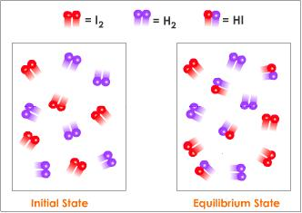
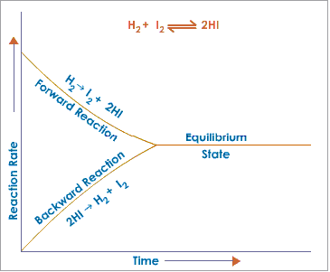
Chemical Equilibrium

Slide 2
Reversible Reactions
Most chemical reactions are reversible. What does this mean?
The products of a chemical reaction, under certain conditions, can be combined to re-form the reactants.
What are those conditions?
Sometimes they are similar to the reaction that formed the products, sometimes not.
All such reactions are referred to as reversible reactions, not matter what route it takes to get there.

Slide 3
When hydrogen gas is passed over magnetic iron oxide, iron and steam are produced:
Fe₃O₄(s) + 4H₂(g) → 3Fe(s) + 4H₂O(g) eq. 1
Passing steam over red-hot iron gives the opposite reaction: magnetic iron oxide is produced, and hydrogen gas is liberated.
3Fe(s) + 4H₂O(g) → Fe₃O₄(s) + 4H₂(g) eq. 2

Slide 4
Fe₃O₄(s) + 4H₂(g) → 3Fe(s) + 4H₂O(g) 3Fe(s) + 4H₂O(g) → Fe₃O₄(s) + 4H₂(g)
If the water vapor in eq. 1 is allowed to escape, the second reaction cannot occur.
Similarly, if hydrogen gas is removed from the reaction vessel in eq. 2, no iron can be formed.

Slide 5
Fe₃O₄(s) + 4H₂(g) → 3Fe(s) + 4H₂O(g) 3Fe(s) + 4H₂O(g) → Fe₃O₄(s) + 4H₂(g)
If we begin with conditions that produce eq. 1, iron and steam are produced. Eq.2 will not occur in significant amounts because there is not enough iron and steam formed.
As the reaction progresses, however, the reactions in equation 2 start becoming significant. The reaction in equation 1 slows down, while the reaction in equation 2 speeds up.
Eventually they reach a state where
the rate of reaction 1 = the rate of reaction 2.

Slide 6
Chemical Equilibrium
When this happens, the system is said to be in chemical equilibrium:
Note that for reactions in equilibrium, arrows in both directions are used.
The substances on the left are called reactants, and the substances on the right are called products.

Slide 7
H₂(g) +I₂(g) ↔2HI(g)

Slide 8
Equilibrium Position
In chemical equilibrium, the rates of the forward and reverse reactions are the same. What about the concentrations of products and reactants, are they the same?
No! Concentrations of the components of chemical reactions can be radically different.
Equilibrium position – of a reaction is given by the relative concentrations of the components of the system at equilibrium.

Slide 9
In the hypothetical reaction shown above, the formation of B is greatly favored over the formation of A. The longer arrow indicates the favored direction of the reaction.
When all reactants are converted to products, we say that the reaction has gone to completion, or is irreversible.
When reactants are mixed, yet no products are formed, we can say that there is no reaction.
Reversible reactions are somewhere in between these two extremes.

Slide 10
Disturbing Equilibrium
When a system is at equilibrium, there is a delicate balance between product and reactant formation.
This balance can be disturbed, or “stressed” in a number of ways
Changing concentration – if one or more of the substances involved in a reaction changes, the equilibrium will be disturbed and the relative concentrations of products and reactants will change.

Slide 11
At equilibrium, 99% of the carbonic acid has decomposed.
If we add CO₂, the equilibrium is stressed. What happens? The ratio of CO₂/H₂CO₃ increases temporarily to greater than 99:1, but not for long!
That added CO₂ will react with water to form carbonic acid, restoring the original ratio. Thus,
Adding a product pushes a reversible reaction in the direction of the reactants.

Slide 12
The same process occurs if we remove CO₂ instead of adding it – initially the ratio of CO₂/H₂CO₃ declines, but this is followed by increased decomposition of carbonic acid:
Removing a product pushes a reversible reaction in the direction of products.
These properties of equilibria are often used to increase yields of chemical reaction – products are removed as soon as they are formed, so the system is continually stressed and produces more products.

Slide 13
Changing Temperature
Changing Temperature – increasing the temperature causes the equilibrium to shift in the direction of the reaction that absorbs heat – the endothermic reaction. Thus we can consider heat to be a product.
A + B 🡪 AB + Heat
Given this hypothetical reaction, what would happen to the equilibrium if you added heat to the reaction vessel? What would happen if you cooled the reaction vessel?

Slide 14
Given the equilibrium reaction at constant pressure: 2HBr(g) + 69.6 kJ ↔ H₂(g) + Br₂(g)
When the temperature is increased, the equilibrium will shift to the
right, and the concentration of HBr(g) will decrease
right, and the concentration of HBr(g) will increase
left, and the concentration of HBr(g) will decrease
left, and the concentration of HBr(g) will increase

Slide 15
An increase in the temperature of a system at equilibrium favors the
endothermic reaction and decreases its rate
endothermic reaction and increases its rate
exothermic reaction and decreases its rate
exothermic reaction and increases its rate

Slide 16
Changing Pressure
For gases, a change in pressure will have no effect on the equilibrium if the reactants have the same number of molecules (moles) as the products.
However, if the number of moles of product is different from the number of moles of reactant, pressure changes have dramatic effects on equilibrium.

Slide 17
Given the reaction: 2N₂(g) + O₂(g) ↔ 2N₂O(g)
Which statement is true when this system reaches equilibrium?
All of the N₂(g) has been consumed.
All of the O₂(g) has been consumed.
Pressure changes no longer occur.
The forward reaction no longer occurs.

Slide 18
Given the reaction at equilibrium: 2CO(g) + O₂(g) ↔ 2CO₂(g)
When the reaction is subjected to stress, a change will occur in the concentration of
reactants, only
products, only
both reactants and products
neither reactants nor products

Slide 19
A(g) + 3B(g) ↔ 2C(g)
Note that in this reaction, the products have half the number of moles as the reactants do.
When this reaction proceeds, the pressure is reduced.
Let’s say you have the above reaction in a container, and you reduce the pressure further. What happens?
Reducing pressure pushes the reaction towards the reactants.
To restore the original pressure, product “C” decomposes to A and B, increasing the number of molecules.

Slide 20
Le Chatelier’s Principle
The relationships between equilibrium and concentration, temperature, and pressure were elucidated by Henri-Louis Le Chatelier at the turn of the century.
In particular, he was interested in producing ammonia from hydrogen and nitrogen:
N₂(g) + 3H₂(g) ↔ 2NH₃(g)
Although he didn’t succeed in creating an industrial process for ammonia production, another scientist, Fritz Haber, was successful.
Le Chatelier’s work is summarized in a simple statement, Le Chatelier’s Principle.

Slide 21
Le Chatelier’s Principle
If a stress is applied to a system, in a dynamic equilibrium, the system changes to relieve the stress.
This statement applies to concentration changes, temperature changes, and pressure changes.

Slide 22
Ammonia is produced commercially by the Haber reaction: N₂(g) + 3H₂(g) ↔ 2NH₃(g) + energy
The formation of ammonia is favored by
an increase in pressure
a decrease in pressure
removal of N₂(g)
removal of H₂(g)

Slide 23
Given the equation representing a reaction at equilibrium: N₂(g) + 3H₂(g) ↔ 2NH₃(g) + energy
Which change causes the equilibrium to shift to the right?
decreasing the concentration of H₂(g)
decreasing the pressure
increasing the concentration of N₂(g)
increasing the temperature

Slide 24
In which reaction at equilibrium will the point of equilibrium shift to the right when the pressure decreases at constant temperature?
N₂(g) + 3H₂(g) ↔ 2NH₃(g)
H₂(g) + Br₂(g) ↔ 2HBr(g)
CaCO₃(s) ↔ CaO(s) + CO₂(g)
N₂(g) + O₂(g) ↔ 2NO(g)

Slide 25
Given the reaction: 2Na(s) + 2H₂O(l) → 2Na⁺(aq) + 2OH⁻(aq) + H₂(g)
This reaction goes to completion because one of the products formed is
an insoluble base
a soluble base
a precipitate
a gas

Slide 26
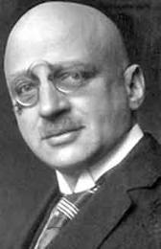
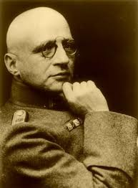
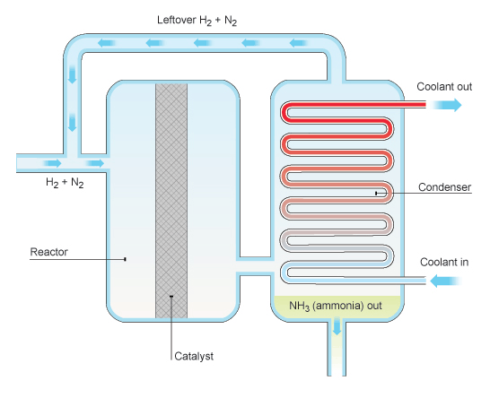
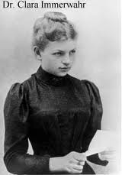
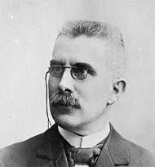
The Haber Process
N₂(g) + 3H₂(g) ↔ 2NH₃(g) + 92kJ

Slide 27
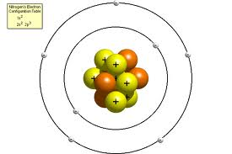
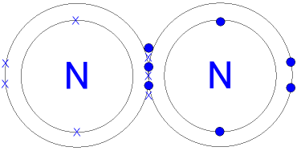
Nitrogen

Slide 28
Haber’s Idea
At 500C, yield is 0.1%!!
At 700 atm, yield is 47%!!

Slide 29
Catalysts and Equilibrium
Catalysts speed up reactions – in both directions!
Catalyists have no effect on the overall outcome of reactions – the equilibrium condition.

Slide 30
Given the reaction at equilibrium:
Which change will not affect the equilibrium concentrations of A(g), B(g), and A₂B₃(g)?
adding more A(g)
adding a catalyst
increasing the temperature
increasing the pressure

Slide 31
Physical Equilibria
Equilibrium also occurs in many physical processes:
- saturated solutions
- phase changes
evaporation of liquids (vapor pressure)
evaporation of solids (sublimation)
condensation of gases to liquids and solids (deposition)

Slide 32
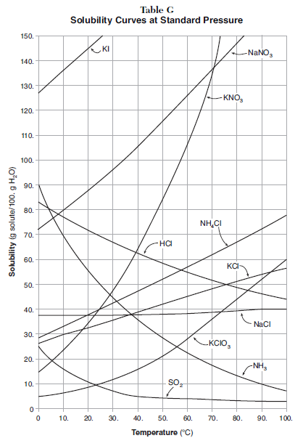
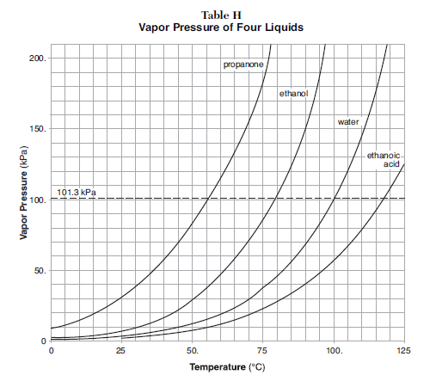
Tables G and H Reflect Physical Equilibrium Processes

Slide 33
Saturated Solutions
For a given compound, any point on the line,
Rate dissolving = rate crystallizing
KNO₃(s) ↔ K⁺(aq) + NO₃⁻(aq)

Slide 34
A solution in which the crystallizing rate of the solute equals the dissolving rate of the solute must be
saturated
unsaturated
concentrated
dilute

Slide 35
Which statement must be true when solution equilibrium occurs?
The solution is at STP.
The solution is supersaturated.
The concentration of the solution remains constant.
The masses of the dissolved solute and the undissolved solute are equal.

Slide 36
Given the closed system at equilibrium: CO₂(g) ↔ CO₂(aq)
As the pressure on the system increases, the solubility of the CO₂(g)
decreases
increases
remains the same

Slide 37
Given the reaction: AgI(s) ↔ Ag⁺(aq) + I⁻(aq)
Solution equilibrium is reached in the system when
the rate of dissolving reaches zero
the rate of crystallization reaches zero
the rate of dissolving is zero and the rate of crystallization is greater than zero
both the rate of dissolving and the rate of crystallization are equal and greater than zero

Slide 38
Given the reaction:
Once equilibrium is reached, which statement is accurate?
The concentration of Ag⁺(aq) is greater than the concentration of Cl⁻ (aq).
The AgCl(s) will be completely consumed.
The rates of the forward and reverse reactions are equal.
The entropy of the forward reaction will continue to decrease.

Slide 39
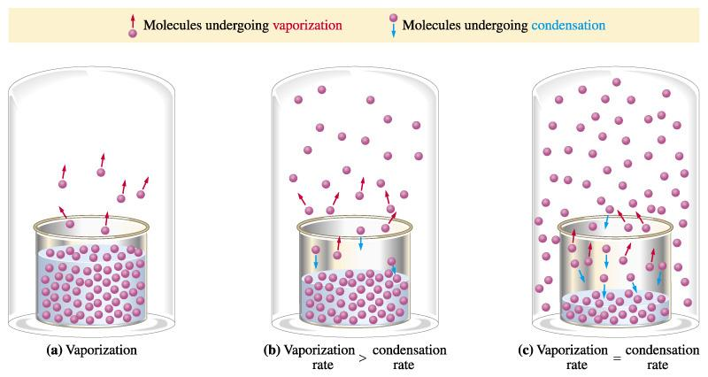
Evaporation of Liquids
In a sealed container, liquids quickly reach equilibrium with their vapor:
Rate evaporation = rate condensation
H₂O(l) ↔ H₂O(g)

Slide 40
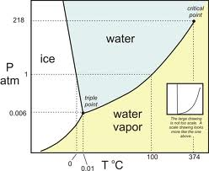
I₂(s) ↔ I₂(g)
CO₂(s) ↔ CO₂(g)

Slide 41
Which type or types of change, if any, can reach equilibrium?
a chemical change, only
a physical change, only
both a chemical and a physical change
neither a chemical nor a physical change

Slide 42
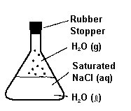
Which equation represents a system that will reach equilibrium in the flask?
NaCl(s) ↔ NaCl(l)
NaCl(s) ↔ H₂O(l)
H₂O(g) ↔ NaCl(aq)
H₂O(g) ↔ H₂O(l)

